Slide 2
Learning intentions
Students must be able to: -Explain the meaning of ‘history’ and ‘prehistory’ -Distinguish between historical sources -Identify where historians get their sources | Students should be able to: -Demonstrate awareness of historical concepts (ideas) -Demonstrate chronological awareness/Explain how historians measure time -Explain how historians interpret sources | Students could be able to: -Debate the usefulness and limitations of different kinds of sources

Slide 3
How do historians find out about the past?
History is the study of the past based on evidence.
Prehistory is the history before writing was invented.
Historians use sources as evidence to prove or disprove the story of the past.
SB P1 – The History of Me!

Slide 4
How are sources grouped together?
Primary sources are sources that come directly from the time being studied.
They are first-hand accounts of what happened, e.g. The Diary of Anne Frank.

Slide 5
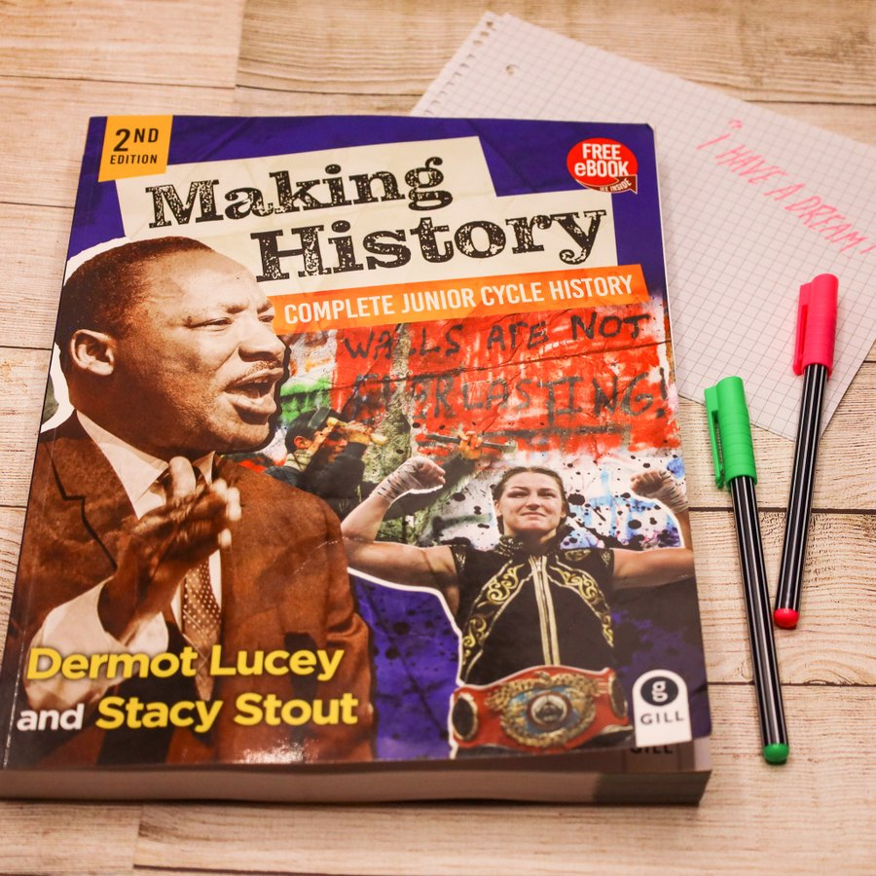
Secondary sources were made or created after the time being studied e.g. Making History.
SB P2 – Video Worksheet

Slide 6
Sources come in many different forms.
Type of source | Examples
1. Written sources | -Manuscripts (books written by hand) -Autobiography -Biography -Census (population count) -Newspapers
2. Visual sources | -Paintings, photographs, documentaries -Cartoons and drawings -Maps
3. Aural sources (sources that can be heard) | -Recordings of interviews and speeches -Podcasts
4. Oral sources (sources that are spoken) | -Interviews -Recordings
5. Tactile sources (sources that can be touched) | -Artefacts (objects made by people) -Buildings -Monuments -Models
SB P3 – Classify the Primary and Secondary Sources

Slide 7
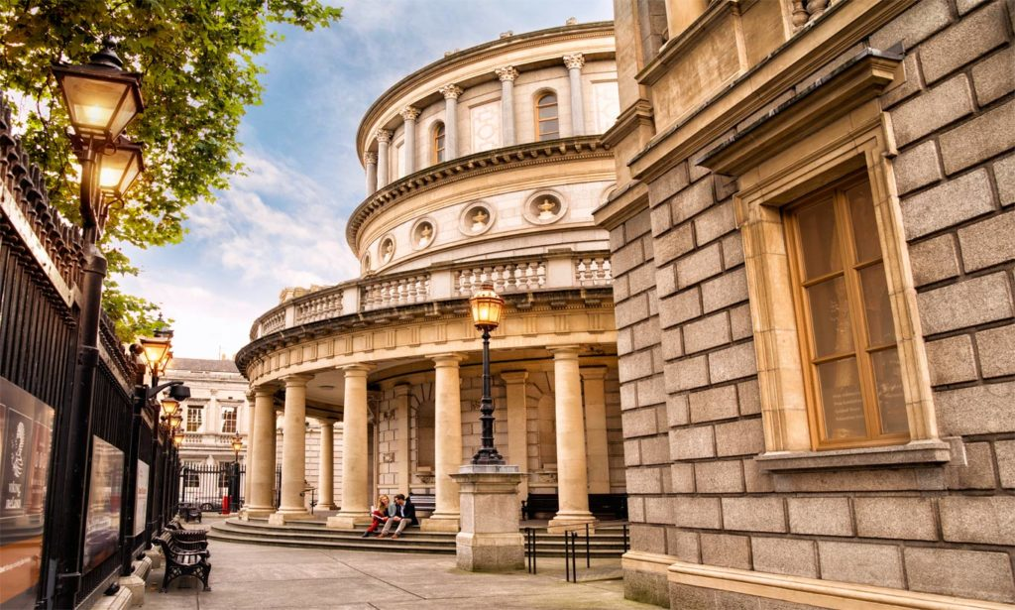
Where do historians get their sources?
Archives – this is a collection of mainly written sources, e.g. the National Archives in Dublin.
Museum – collects and stores artefacts, e.g. the National Museum in Dublin.
Library – stores books.
Websites.
Interviews.
TB P4 – Assessing your learning

Slide 8
How do historians use sources?
Historians must distinguish between fact (something that can be proven with evidence) and opinion (what one or more people think about what happened).
It is the job of a historian to be objective.
Historians must look out for bias (favouring one side over the other).

Slide 10
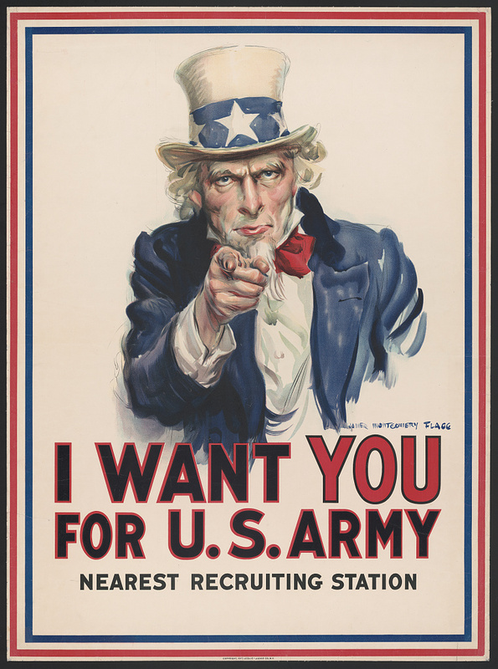
What are the problems with sources?
Some sources are deliberately written or created to persuade people to support a cause or person. This is called propaganda.
Propaganda is using information to influence people’s opinions.

Slide 11
What are the strengths and limitations (weaknesses) of some sources?
Draw the table into your hardback. Use TB pages 8-9 to complete the table.
Type of source | Strength | Limitations
Primary
Secondary
Written
Visual
Aural
Oral
Tactile

Slide 12
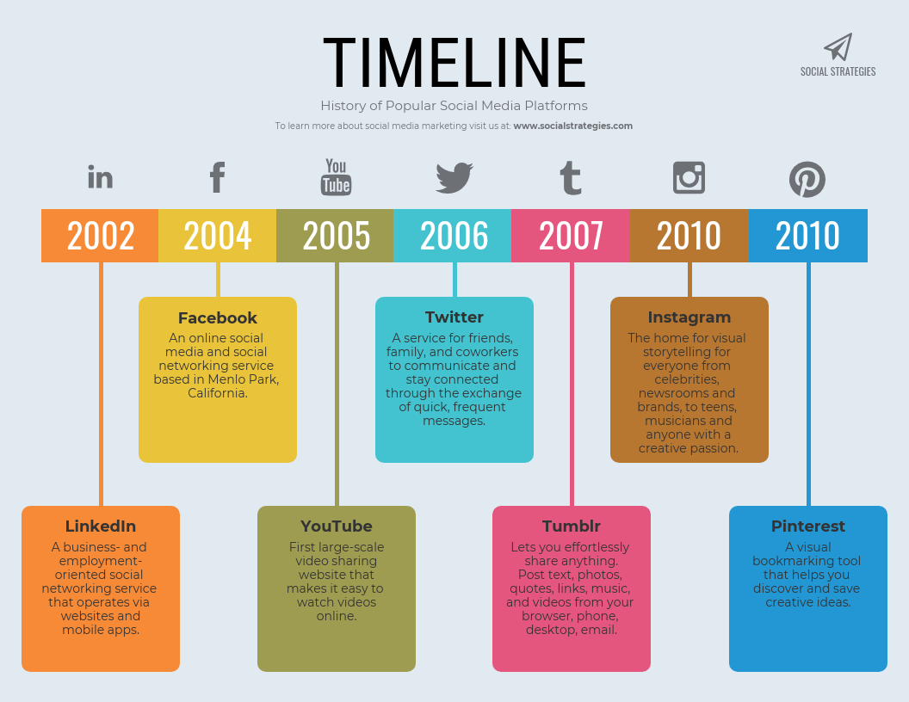
Historians and time
The study of dates and time is called chronology.
Chronological order means putting events in the order in which they occurred, starting with the earliest.
10 years = a decade.
100 years = a century. 2022 is in the 21st century. 1589 is in the 16th century.
BC = before Christ.
AD = (Anno Domini, the year of our Lord)
SB P4 – Chronological order
SB P5 – Source analysis
TB P10 – Assessing your learning

Slide 13
SB P7 – End of chapter source question and Key Words
TB P11 – Review Questions

